Slide 1
Heart disease detection using Machine Learning AND FLASK API
Presented by:
M. Aneesh Reddy-160118735023
K.Anurag-160118735024
Guided by:
Sri. G.V. Pradeep Kumar
Assistant Professor,Dept of ECE, CBIT

Slide 2

Aim
Heart disease detection system aims to exploit machine learning algorithm on medical data set to assist in the prediction of the heart diseases.
1

Slide 3
Objectives
1). The main objective of this research is to develop a heart disease detection system.
2). To compare the accuracies of machine learning algorithms.
3). To Reduce the cost of medical tests.
2

Slide 4
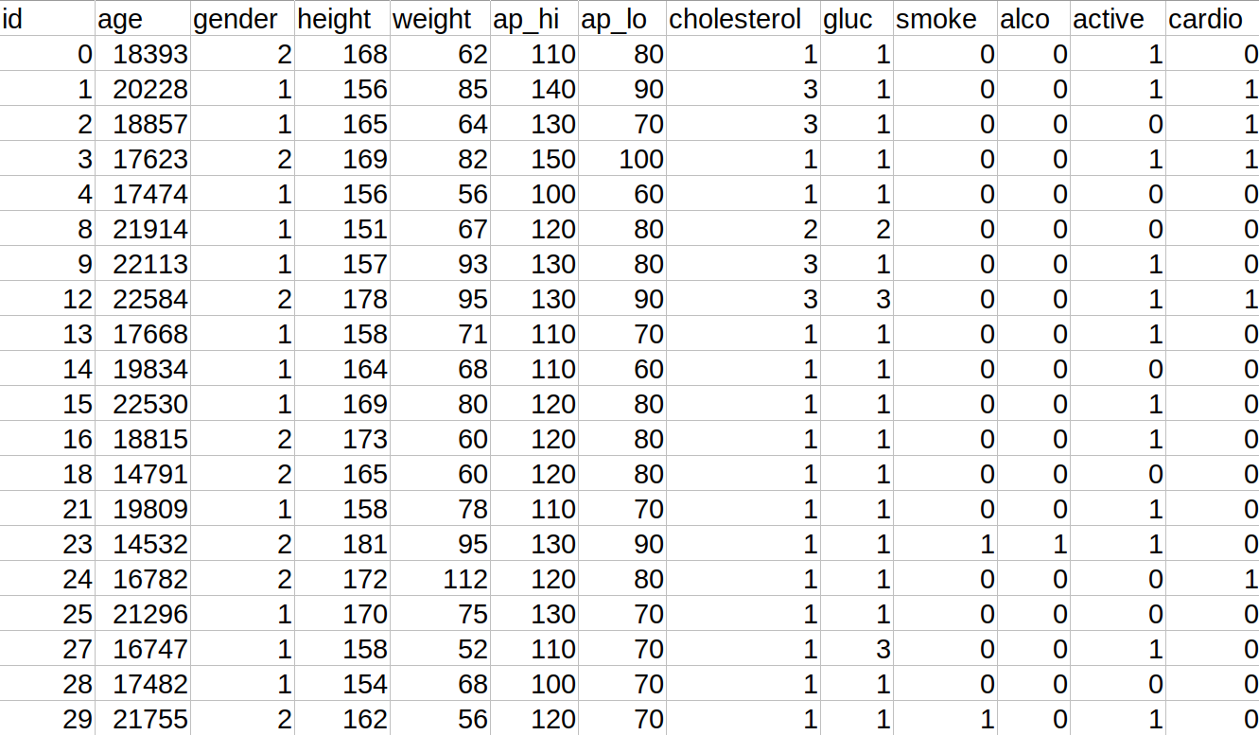
Data Set
3

Slide 5
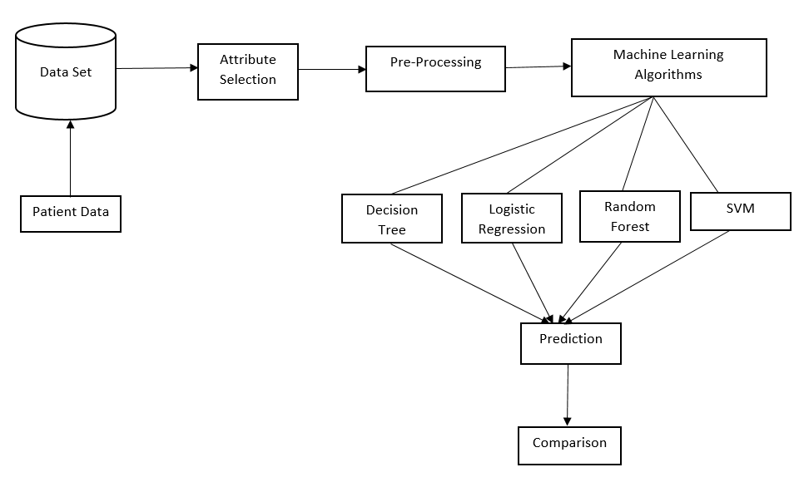
Design Methodology
Linear
Regression
4

Slide 6
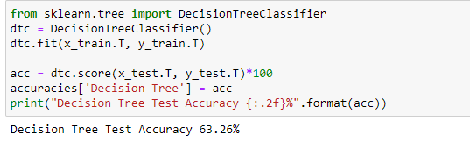
Decision tree
Decision Tree algorithm belongs to the family of supervised learning algorithms.
Decision Trees, for predicting a value for a record we start from the root of the tree. We compare the values of the root attribute with the record’s attribute. On the basis of comparison, we follow the branch corresponding to that value and jump to the next node.
5

Slide 7
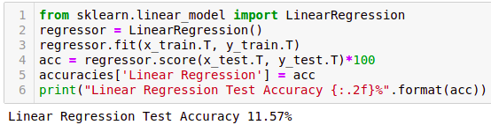
Linear Regression
It is also known simply as multiple regression, is a statistical technique that uses several explanatory variables to predict the outcome of a response variable.
Linear regression analysis is used to predict the value of a variable based on the value of another variable. The variable you want to predict is called the dependent variable. The variable you are using to predict the other variable's value is called the independent variable.
6

Slide 8
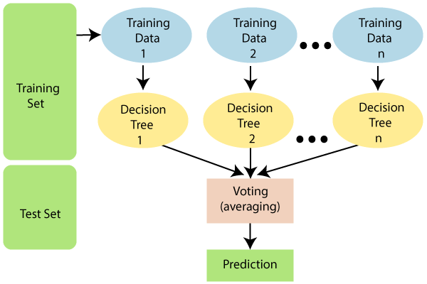
Random Forest
Random Forest is a classifier that contains a number of decision trees on various subsets of the given dataset and takes the average to improve the predictive accuracy of that dataset.
Instead of relying on one decision tree, the random forest takes the prediction from each tree and based on the majority votes of predictions, and it predicts the final output.
7

Slide 9
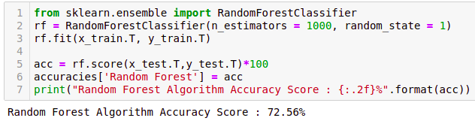
8
Notes:
9

Slide 10
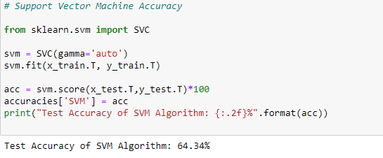
Support Vector Machine
Support Vector Machine(SVM) is a supervised machine learning algorithm used for both classification and regression. Though we say regression problems as well its best suited for classification. The objective of SVM algorithm is to find a hyperplane in an N-dimensional space that distinctly classifies the data points. The dimension of the hyperplane depends upon the number of features. If the number of input features is two, then the hyperplane is just a line. If the number of input features is three, then the hyperplane becomes a 2-D plane. It becomes difficult to imagine when the number of features exceeds three.
9

Slide 11
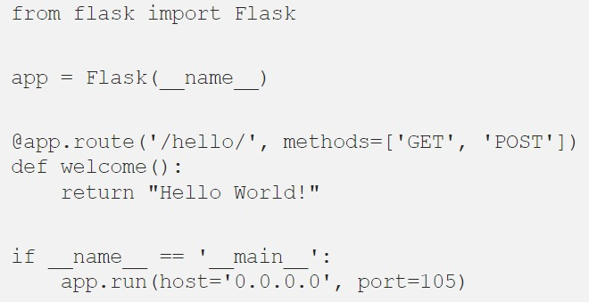
Flask API
Flask is a web development framework developed in Python.
Flask is known as a micro-framework because it is lightweight and only provides components that are essential. It only provides the necessary components for web development, such as routing, request handling, sessions, and so on.
10

Slide 12
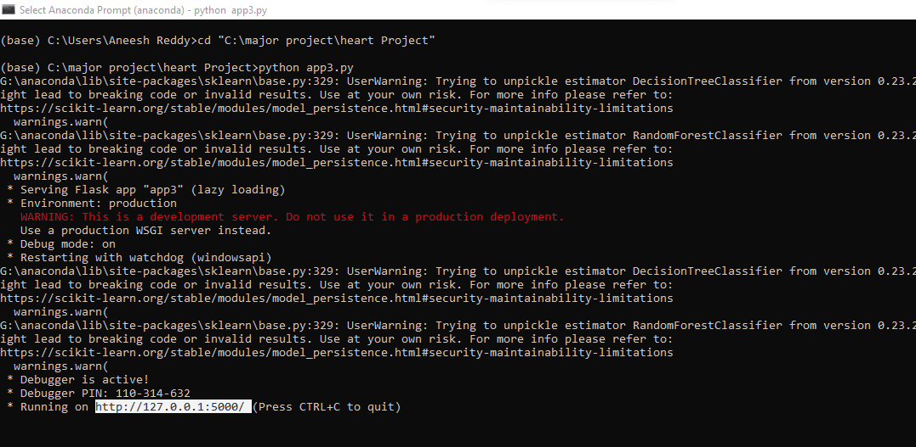
Accessing the interface
11

Slide 13
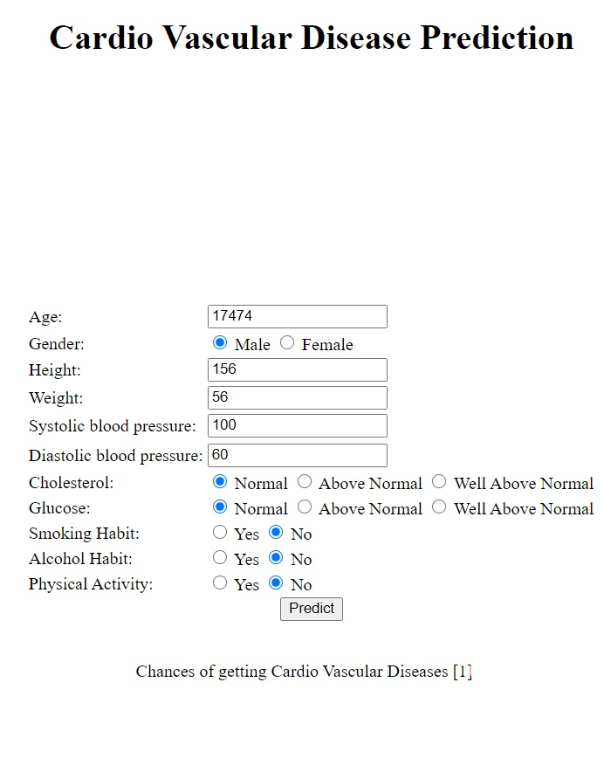
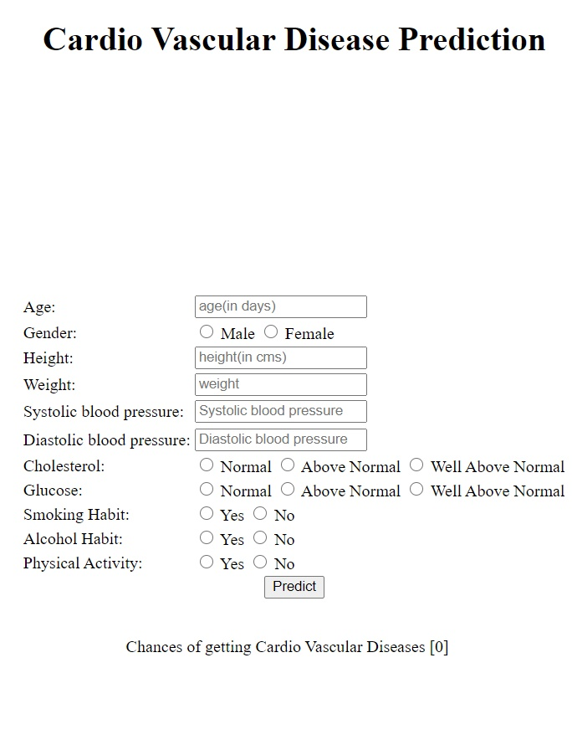
Results
Test case - 1
12

Slide 14
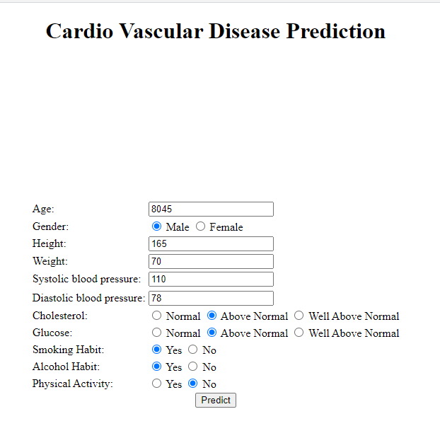
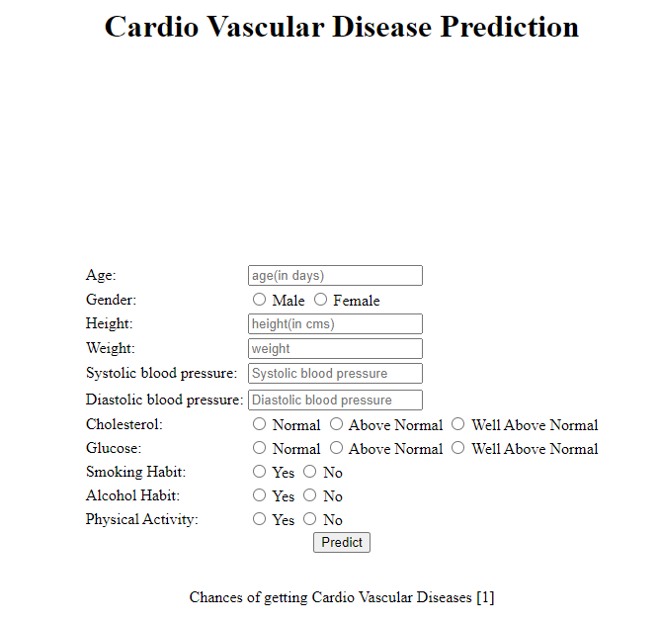
Test case 2
13

Slide 15
Conclusion
The accuracies of Various algorithms are compared and random forest has been proven to have more accuracy.
This model proposes a random forest algorithm using python for the prediction of heart disease diagnosis. Thus, the proposed model gives the best predicted values with high accuracy.
This heart detection system is cost efficient.
14

Slide 16
Future scope
1). Future work of this model can be done to improve the accuracy. There is need of more complex techniques to obtain better accuracy. Adding of other feature attribute might improve this model.
2). This could be used in the application for android and ios with user-friendly interface for early diagnosis of cardiovascular disease.
15

Slide 17
References
[1] “Multi Disease Prediction Model by using Machine Learning and Flask API “, proceedings of the Fifth International Conference on Communication and Electronics Systems (ICCES 2020) IEEE Conference Record # 48766; IEEE Xplore ISBN: 978-1-7281-5371-1.
[2] T. K. Ho, “The random subspace method for constructing decision forests”, IEEE Transactions on Pattern Analysis and Machine Intelligence, 1998.
[3] M. Marimuthu, M. Abinaya, K. S. Hariesh , K.Madhankumar, V.Pavithra , ‘‘A Review on Heart Disease Prediction using Machine Learning and Data Analytics Approach’’, International Journal of Computer Applications (0975 – 8887) Volume 181 – No. 18, September 2018.
[4] H. Benjamin Fredrick David and S. Antony Belcy, ‘‘Hear Disease Prediction Using Data Mining Techniques.’’, ICTACT Journal on soft computing, October 2018, Volume:09, Issue: 01
16

Slide 18
Thank You

